Slide 1




Epidemic Modelling Frameworks for Studying Infectious Disease Dynamics
Daniele Baccega, Marco Beccuti, Simone Pernice, Irene Terrone
13TH IEEE International Conference on Healthcare Informatics
University of Calabria, Rende, Italy
18th-21st June, 2025

Slide 2


Outline
Who are we?
Overview of computational models in epidemiology (∽15 min).
Macro-level models (∽1 hour).
Case study: GreatMod.
Micro-level models (∽1 hour).
Case study: Forge4Flame.
From macro to micro (∽15 min).
Conclusion (∽5 min).
http://github.com/qBioTurin/IEEEICHI2025

Slide 3
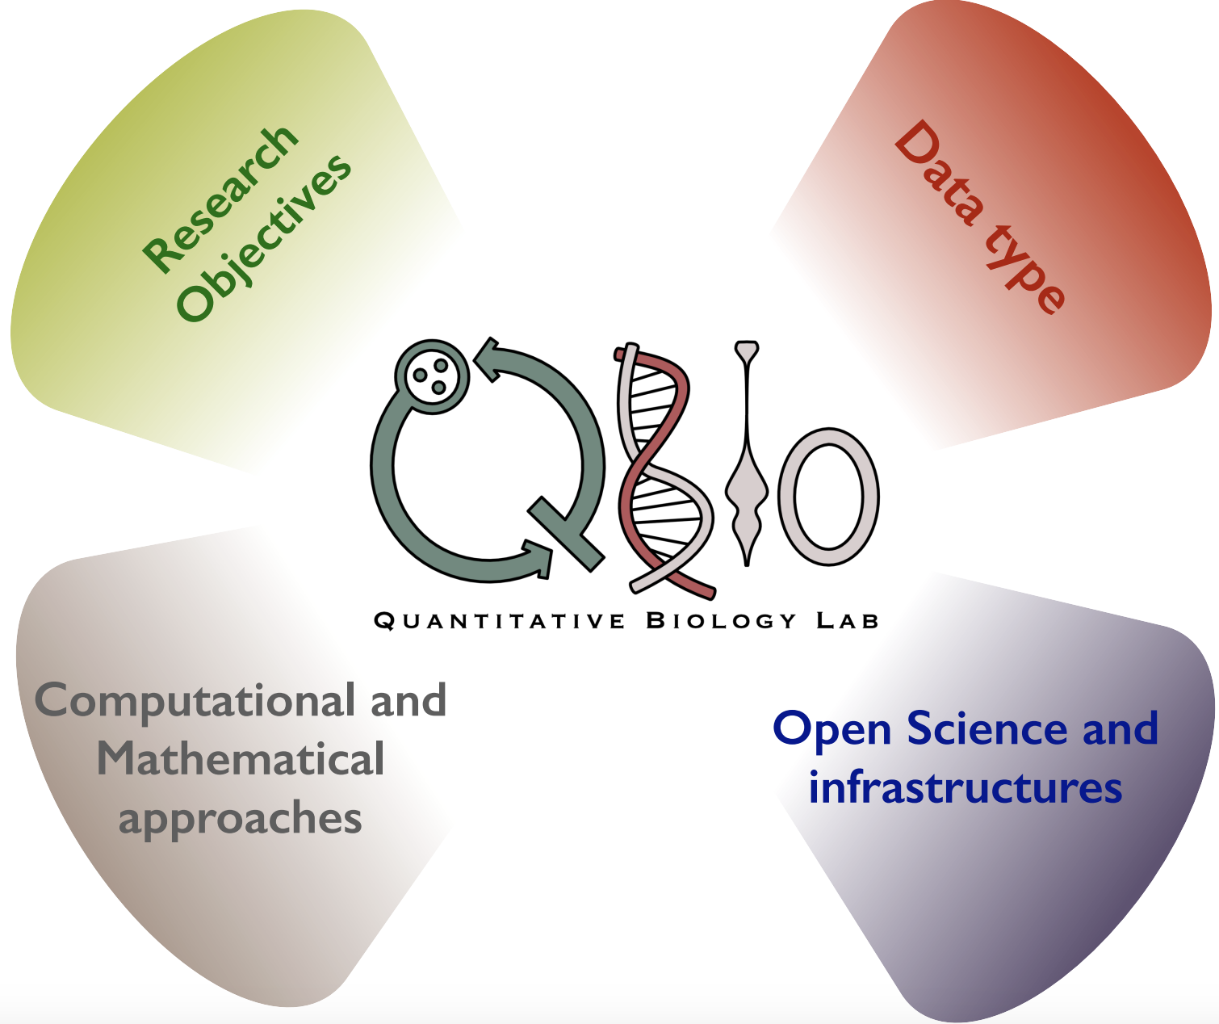
Who are we?
Research Objectives:
Patient stratification
Identification of diagnostic and prognostic biomarkers
Epidemiological models
Mathematical models for cancer progression and treatment response
Evolutionary Genomics and Modelling
Basic Research: Cancer Genomics and Epigenomics
https://qbio.di.unito.it/

Slide 4
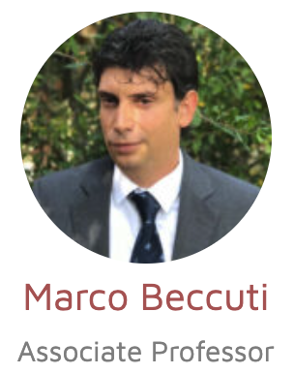



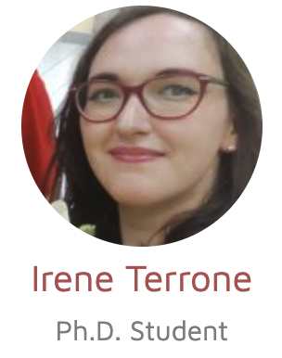
Who are we?
Marco Beccuti is currently associate professor at the Department of Computer Science of the University of Turin, scientific coordinator of InfoLife National Laboratory of CINI, scientific coordinator of the laboratory “HPC for biomed and AI” in ICxT, Chair of the Scientific Committee of the “HPC4AI” laboratory” at the University of Turin.
Daniele Baccega is a Post Doc researcher at the Department of Computer Science of the University of Turin. He holds a National PhD in Artificial Intelligence (Health and Life Sciences). His current research activities mainly involve computational epidemiology, deep learning, and data analysis.
Simone Pernice is currently assistant professor at the Department of Computer Science of the University of Turin, coordinator of Young InfoLife group of the Infolife National Laboratory of CINI. His current research activities mainly involve computational epidemiology, modeling of complex biological systems , and longitudinal data analysis.
Irene Terrone is a PhD student at the Department of Computer Science of the University of Turin. Her research project focuses on the creation and study of biological models to analyze the spread and management of epidemics, integrating it with machine learning and generating models.

Slide 5
Who's presenting what?
Introduction
Macro-level models
Micro-level models
From macro to micro level models
Case studies:
GreatMod
Forge4Flame

Slide 6

Introduction

Slide 7
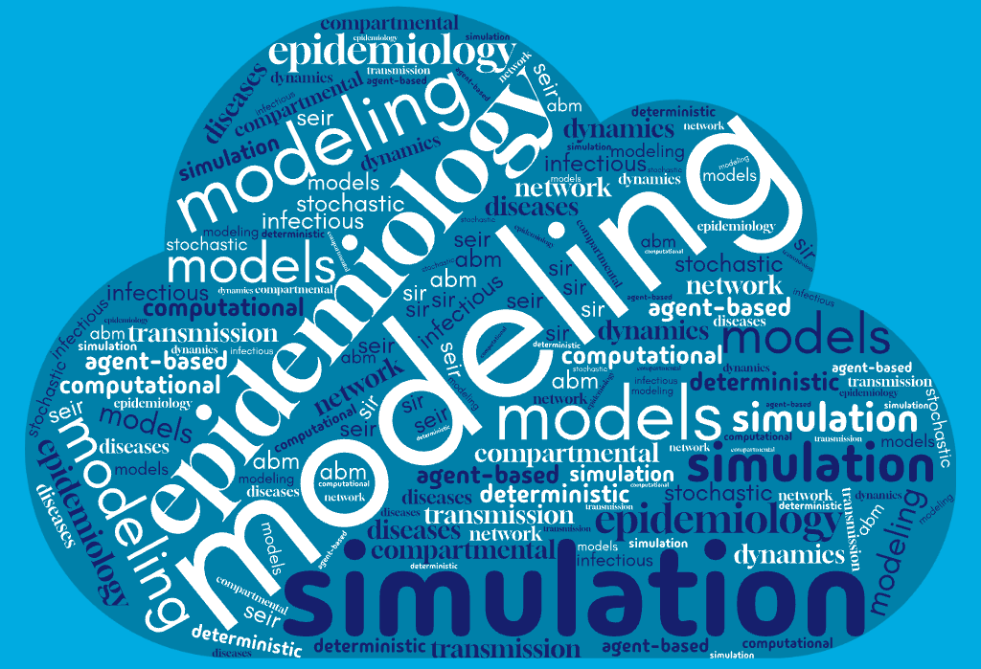
Computational modelling
Definition
The use of mathematics, statistics, physics and computer science to study the mechanism and behavior of complex systems by computer simulation.
Applications in different fields:
Network analysis, manufacturing systems, resource management, weather forecasting, clinical decision support, tracking infectious diseases, ...

Slide 8





Computational epidemiology
Definition
A multidisciplinary field that uses computational methods to simulate, analyze, and predict the spread of diseases within populations.
Key Components:
Epidemiological Models: SIR, SEIR, …
Computation: Simulation approach, parameter estimation, data assimilation
Data Sources: Case counts, mobility, demographics, contact networks
Handles complex systems with many interacting parts
Enables what-if scenarios and policy testing
Allows for rapid analysis using real-time data

Slide 9
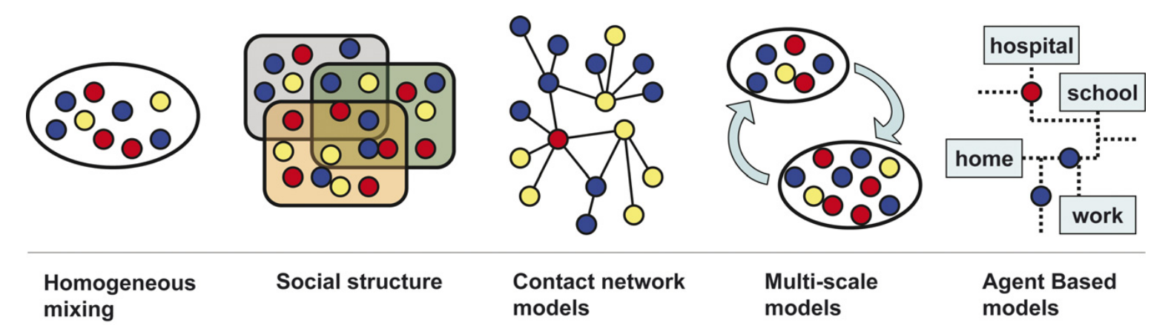


Different modelling approaches
Macro-level
Abstraction
Micro-level
Colizza, Vittoria, et al. Epidemic modeling in complex realities. Comptes rendus biologies 330.4 (2007).

Slide 10
Different modelling approaches
Homogeneous mixing: assumes that every individual in a population is equally likely to interact with every other individual and treats the population as a well-mixed group without any structure, where interactions happen randomly and uniformly.
Real-World Use Case: Estimating how fast an infectious disease might spread in a new outbreak, by assuming homogeneous mixing to estimate:
How many people might be infected in 30 day
What the basic reproduction number R0​ is
Whether the healthcare system will be overwhelmed
Model Type: SIR or SEIR compartmental model using ordinary differential equations (ODEs), assuming population is like a "well-stirred soup"

Slide 11
Different modelling approaches
Social structure: accounts for the fact that individuals belong to different social groups or communities, based on factors such as age, economic status, region, and other demographic characteristics.
Real-World Use Case: Evaluating the impact of closing schools vs. workplaces and adding and age structure, to simulate how transmission changes:
If schools are closed but workplaces stay open
If elderly reduce contact but younger groups don't
Model Type:
Structured compartmental models
Age-stratified or region-based SIR/SEIR
Matrix of contact rates between groups

Slide 12
Different modelling approaches
Contact network models: represent the population as a network, where nodes represent individuals, and edges represent the interactions or connections between them.
Real-World Use Case: Identifying and managing super-spreader events. The model identifies individuals with many connections (hubs) who could become super-spreaders. It helps simulate:
What happens if these hubs isolate?
How fast the outbreak could spread through friend networks
Model Type:
Graph-based models
(nodes = individuals, edges = interactions)
Network epidemiology

Slide 13
Different modelling approaches
Multi-scale models: integrate multiple levels of interaction, such as individual, group, and population levels, and consider the effects across these different scales.
Real-World Use Case: Understanding national-level spread and regional control strategies.
People interact at home, work, school
Movement happens between cities (commuting, travel)
Local healthcare capacity varies by region
Model Type:
Hybrid models combining ODEs, networks, and spatial interactions
Useful for modeling regional or national dynamics with local resolution

Slide 14
Different modelling approaches
Agent-based models: simulate the actions and interactions of individual agents (such as people or organizations) within specific environments. They consider different locations or settings (e.g., city, neighborhood, hospital, school, work, home) and model how agents move between these locations and interact based on defined rules.
Real-World Use Case: Testing the effectiveness of behavioral and spatial interventions. The model explores:
What if 60% of people wear masks?
What if gyms close but offices remain open?
How does work-from-home affect the spread?
Model Type:
Individual-based simulation
High computational cost but rich insights
Allows for testing interventions like mask mandates

Slide 15
Macro- and micro-level models
Macro-level
Abstraction
Micro-level
✅ Pros:
Require fewer data and computational resources.
Allow fast simulations on large populations.
Useful for broad forecasts and general policy decisions.
✅ Pros:
Capture individual behaviors and interactions.
Allow detailed, context-specific simulations.
Ideal for testing targeted interventions.

Slide 16
Macro- and micro-level models
Macro-level
Abstraction
Micro-level
✅ Pros:
Require fewer data and computational resources.
Allow fast simulations on large populations.
Useful for broad forecasts and general policy decisions.
✅ Pros:
Capture individual behaviors and interactions.
Allow detailed, context-specific simulations.
Ideal for testing targeted interventions.
❌ Cons:
Do not capture individual behavior or local dynamics.
Assume uniform or simplified mixing patterns.
Less accurate in heterogeneous or small-scale settings.
❌ Cons:
Require detailed, high-resolution data.
Computationally intensive.
More complex to calibrate and validate.

Slide 17
What do you expect from this tutorial?
Can we estimate the impact of interventions like lockdowns or vaccines?
How do individual behaviors affect the epidemic?
What’s the trade-off between simplicity and detail in a model?
When should we use an macro model, and when is a micro model better?

Slide 18
Macro-level models

Slide 19


Macro-level models
The first major class of modeling approaches: Macro-Level Models, often called compartmental models.
These models don’t simulate each person individually. Instead, they divide the entire population into groups, for example:
Susceptible
Infected
Recovered
The beauty of these models is in their simplicity. They help answer questions like:
How fast will the outbreak grow?
What’s the peak number of cases?
What happens if we vaccinate 50% of the population?
We assume the population is well mixed (like stirring soup) where everyone has an equal chance of interacting with everyone else.
So while they don’t give detailed answers about individual behavior, they’re powerful for seeing the big picture.

Slide 20
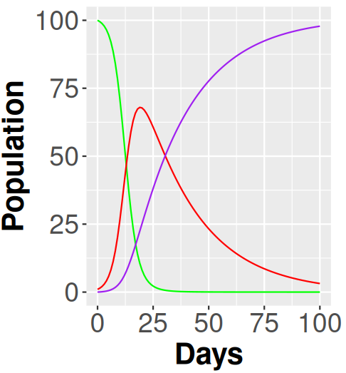
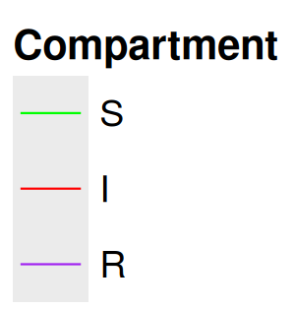
Compartmental model
We assume the population is well mixed (like stirring soup) where everyone has an equal chance of interacting with everyone else.
So while they don’t give detailed answers about individual behavior, they’re powerful for seeing the big picture.
Everyone starts susceptible (S).
When they come into contact with an infected person, they can become infected (I).
After some time, they recover (R) and are no longer infectious.
Susceptible
Infected
Recovered
Individuals can move from the S compartment to the I compartment, but not back. They can also move from the I compartment to the R compartment, but not back. The rates at which these movements between compartments occur determine the dynamics of the model.
SIR compartmental model as a flow diagram
This diagram helps us visualize what we’re modeling

Slide 21

The mathematical processes underlying
Susceptible
Infected
Recovered

Slide 22

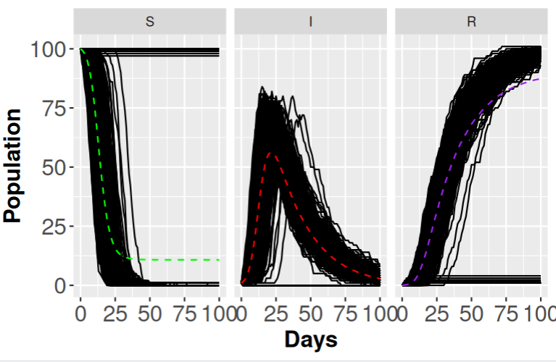

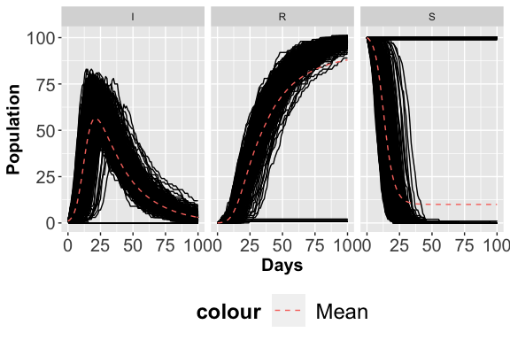
The mathematical processes underlying
Susceptible
Infected
Recovered
Once we have a flow diagram we can go in two directions:
Deterministic approach: we assume the population is large enough that randomness averages out. This leads to ordinary differential equations (ODEs)
Stochastic approach: we recognize that especially in small populations or early outbreak stages, random events matter. This leads to Continuous Time Markov Chain (CTMC).

Slide 23
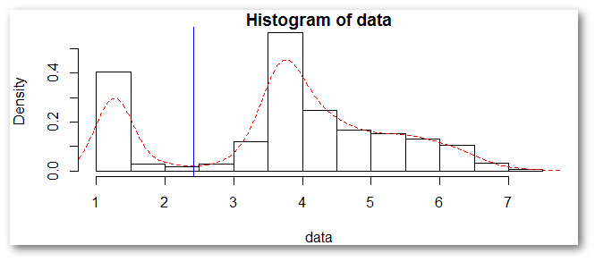
The mathematical processes underlying
Deterministic | Stochastic
Ordinary differential equations | Continuous-time Markov chains
Future is “predictable” given present knowledge | Includes randomness; every simulation is different
Wide range of techniques available for analysis | Not as many techniques for analysis; often rely on simulations
Good for large number of individuals; qualitative analysis | Better for simulating dynamics with small numbers of individuals
Represents population average | Represents population variability
Deterministic models can be solved easier, but they provide only the average system behavior.
Stochastic models are more computationally demanding, but they can capture the stochastic nature of a biological process.

Slide 24
Stochastic approach
Susceptible
Infected
Recovered
The system is in a discrete state:
(#S, #I, #R)
where #S, #I, and #R are integer counts of individuals in each compartment.
In the example, the state is:
(#S = 8, #I = 5, #R = 4)
Two possible stochastic events:
Infection: (S, I, R) → (S−1, I+1, R) with rate β
Recovery: (S, I, R) → (S, I−1, R+1) with rate γ

Slide 25
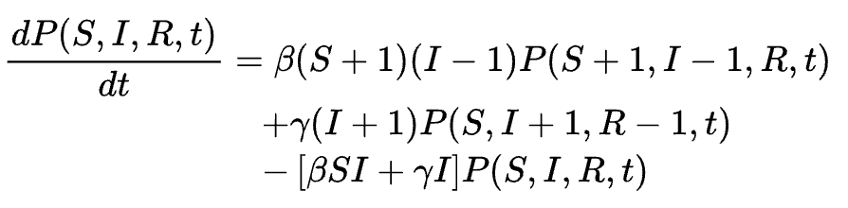
Stochastic approach
Susceptible
Infected
Recovered
The system is in a discrete state:
(#S, #I, #R)
where #S, #I, and #R are integer counts of individuals in each compartment.
In the example, the state is:
(#S = 8, #I = 5, #R = 4)
Two possible stochastic events:
Infection: (S, I, R) → (S−1, I+1, R) with rate β
Recovery: (S, I, R) → (S, I−1, R+1) with rate γ
These Kolmogorov equations (also called master equations) describe how those probabilities to be in a specific state change over time:
probability into state (S, I, R) from a transition into it (someone got infected in the previous state).
probability from someone recovering
P(S, I, R, t) is the probability the system is in state (S, I, R) at time t
subtracts probability, because once someone gets infected or recovers, we leave the current state.

Slide 26

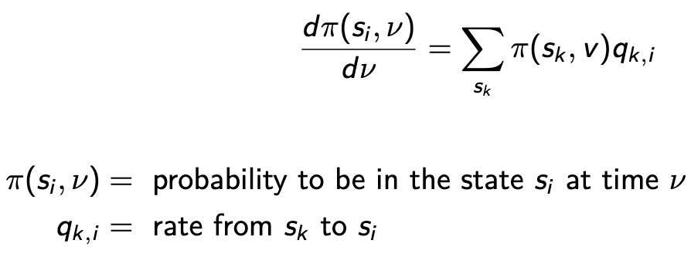
Stochastic approach
Kolmogorov equations:
One Kolmogorov equation per state
State Space Explosion
[1] Gillespie (1977) The journal of physical chemistry
[2] Gillespie (2001) The journal of physical chemistry
[3] T.G. Kurtz (1970) Journal of Applied Probability

Slide 27
Stochastic approach
Kolmogorov equations:
One Kolmogorov equation per state
State Space Explosion
These equations are hard to solve directly for large systems, but they form the foundation of stochastic simulations like Gillespie’s algorithm.
Stochastic Simulation Algorithm [1]:
exact algorithm to simulate the events that might occur in the system
[1] Gillespie (1977) The journal of physical chemistry
[2] Gillespie (2001) The journal of physical chemistry
[3] T.G. Kurtz (1970) Journal of Applied Probability

Slide 28
Stochastic approach
Kolmogorov equations:
One Kolmogorov equation per state
State Space Explosion
These equations are hard to solve directly for large systems, but they form the foundation of stochastic simulations like Gillespie’s algorithm.
Stochastic Simulation Algorithm [1]:
exact algorithm to simulate the events that might occur in the system
τ -leaping algorithm [2] a Poisson approximation to leap over many fast events
Longer simulation with an increasing number of events!!
[1] Gillespie (1977) The journal of physical chemistry
[2] Gillespie (2001) The journal of physical chemistry
[3] T.G. Kurtz (1970) Journal of Applied Probability

Slide 29
Stochastic approach
Kolmogorov equations:
One Kolmogorov equation per state
State Space Explosion
These equations are hard to solve directly for large systems, but they form the foundation of stochastic simulations like Gillespie’s algorithm.
Stochastic Simulation Algorithm [1]:
exact algorithm to simulate the events that might occur in the system
Deterministic Approximation
Mean field analysis (or fluid approximation) [3]
τ -leaping algorithm [2] a Poisson approximation to leap over many fast events
Longer simulation with an increasing number of events!!
[1] Gillespie (1977) The journal of physical chemistry
[2] Gillespie (2001) The journal of physical chemistry
[3] T.G. Kurtz (1970) Journal of Applied Probability

Slide 30
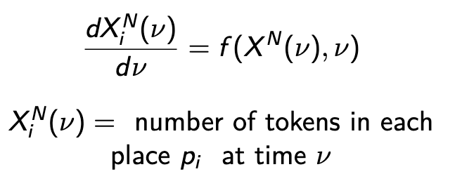
Deterministic approximation
Susceptible
Infected
Recovered
Kolmogorov equations:
Deterministic Approximation
Number of elements in each variable i-th at time ν
Number of Kolmogorov equations
=
Number of all the possible states of the SIR model that can be reached from a specific initial state
One Ordinary Differential equation (ODE) per variable that characterizes the state!
The state (#S, #I, #R): 3 Variables!
If the initial state is (#S = 8, #I = 5, #R = 4) we have more than 60 states

Slide 31
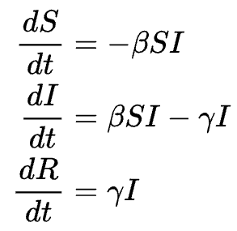
Deterministic approach
Susceptible
Infected
Recovered
People are leaving the susceptible compartment
People are recovering and moving to the R compartment
Solving (integrating) the equations
β: the transmission rate — how often a susceptible and infected person interact
γ: the recovery rate — how fast people leave the infected state

Slide 32
Several compartment models
Susceptible
Infected
Recovered
Exposed
Quarantine
Death
…...
SEIQR Model (Susceptible-Exposed-Infected-Quarantined-Recovered)
Used for: Diseases with quarantine or isolation policies
SIRV Model (Susceptible-Infected-Recovered-Vaccinated)
Used when vaccination is implemented.
SAIR Model (Susceptible-Asymptomatic-Infected-Recovered)
Used for: Diseases with asymptomatic carriers
SEIRD Model (Susceptible-Exposed-Infected-Recovered-Deceased)
Combines latency (E) and death (D) aspects. Realistic for diseases like Ebola or COVID-19

Slide 33

Several compartment models
Susceptible
Infected
Recovered
Exposed
Quarantine
Death
…...
SEIQR Model (Susceptible-Exposed-Infected-Quarantined-Recovered)
Used for: Diseases with quarantine or isolation policies
SIRV Model (Susceptible-Infected-Recovered-Vaccinated)
Used when vaccination is implemented.
It could be useful to have a general modelling framework to simulate the models easily!!!!
SAIR Model (Susceptible-Asymptomatic-Infected-Recovered)
Used for: Diseases with asymptomatic carriers
SEIRD Model (Susceptible-Exposed-Infected-Recovered-Deceased)
Combines latency (E) and death (D) aspects. Realistic for diseases like Ebola or COVID-19

Slide 34

GreatMod
Graphical User Interface:
● Interactive modeling via Petri Net formalism
● Construction and visualization of system dynamics
● User-friendly interface for dynamic system modeling
Epimod Library:
● Simulations of complex systems
● 'What-if' scenario analysis
● Detailed result checking (plots, data visualization)
Docker Containers:
● Simulations reproducibility
● Simplifies deployment, updates, and maintenance
https://qbioturin.github.io/epimod/

Slide 35
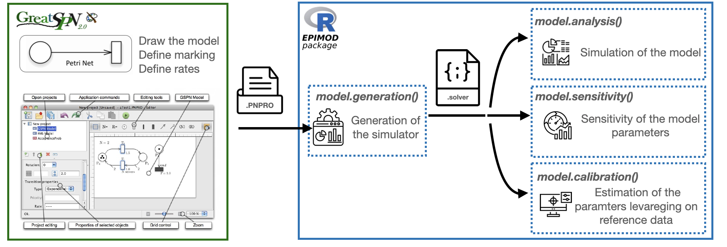
GreatMod
https://qbioturin.github.io/epimod/

Slide 36

Petri Net: a graphical formalism to draw model
Petri Net (PN) is graphical formalism (bipartite graph), conveniently used for the analysis of complex models. It allows us to derive qualitative and quantitative properties of the system.
Places (circles): Represent states or conditions (e.g., a molecule present, a person infected).
Transitions (rectangles): Represent events or actions that change the state (e.g., infection, recovery).
Tokens (dots inside places): Indicate the current state (how many resources or individuals are in a place).
Arcs (arrows): Show how places and transitions are connected (direction matters).

Slide 37
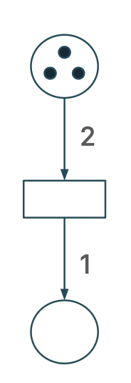
Stochastic Petri Net
Arcs Multiplicity:
● Arcs can have multiplicities, indicating the number of tokens
transferred between places and transitions.
Transitions Firing:
● A transition 'fires' when the input places contain enough
tokens based on the arc multiplicities.
● Firing consumes tokens from input places and produces
tokens in output place
Firing
Firing Rate:
● Determines how quickly a transition converts input tokens into output tokens

Slide 38
Stochastic Petri Net
Exponentially distributed random delays are associated with transition firings (time to wait before the tokens are removed from/ added to places).
The process representing the dynamic of the SPN model is:
Continuous Time Markov Chain
The introduction of time allows to model the temporal dynamics of the system
Marsan, M. Ajmone, et al. "Modelling with generalized stochastic Petri nets." ACM SIGMETRICS performance evaluation review 26.2 (1998): 2.

Slide 39
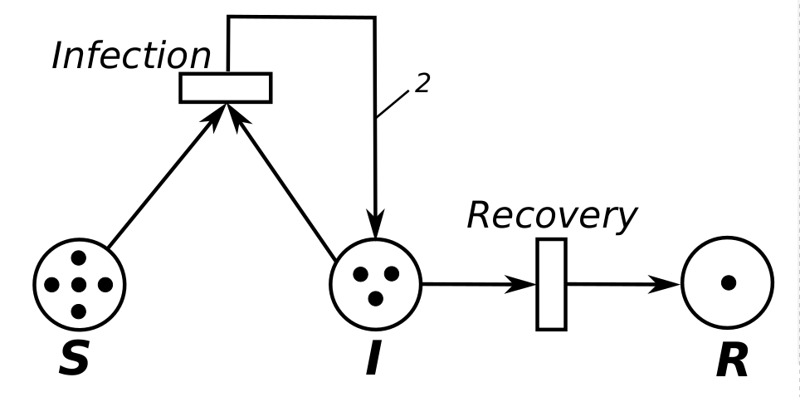
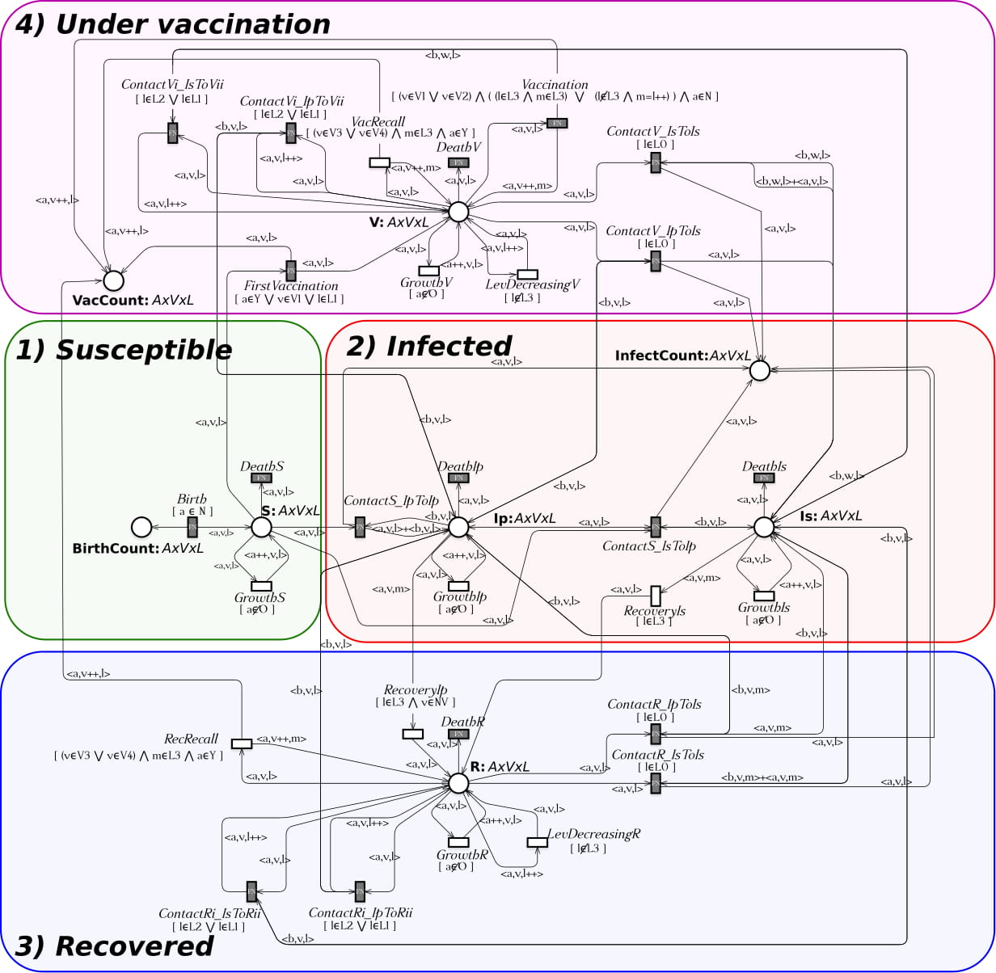
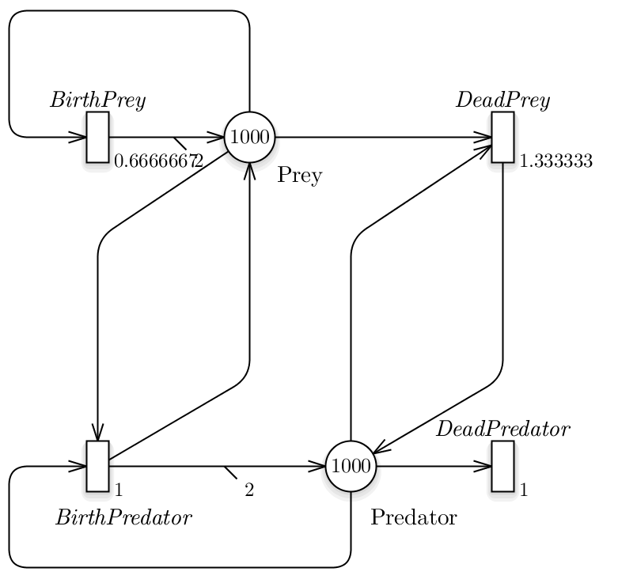
Some examples
Investigation of the pertussis epidemiology in Italy
SIR model,
one of the simplest compartmental models
Predator–prey equations, biological systems in which two species interact
https://qbioturin.github.io/epimod/examples/

Slide 40
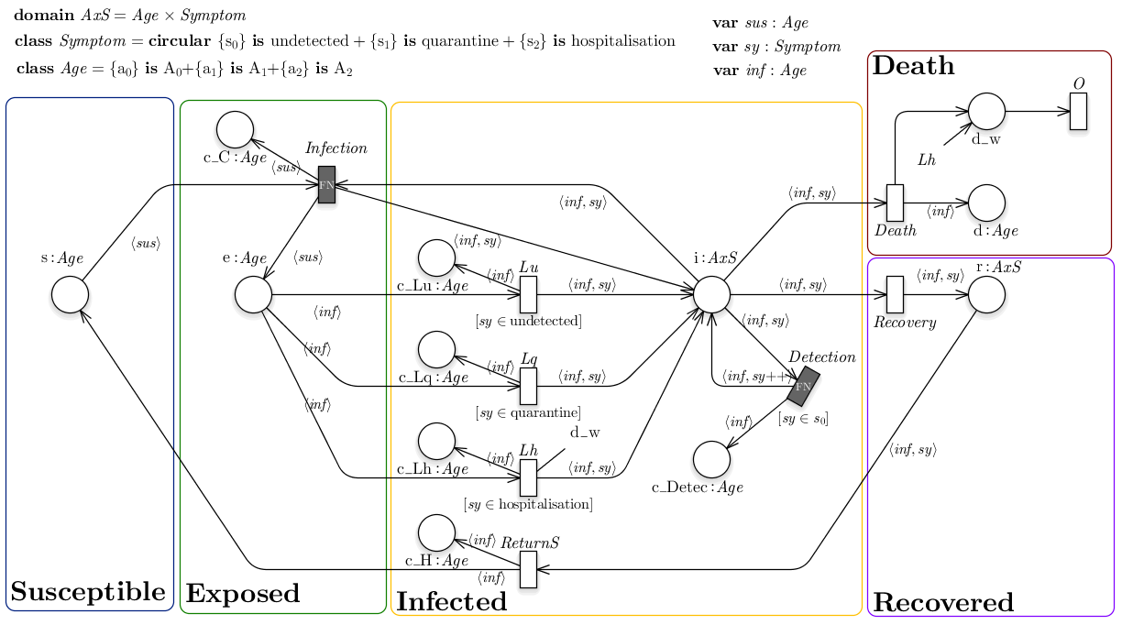
COVID-19 model
Pernice, S., et al. "Impacts of reopening strategies for COVID-19 epidemic: a modeling study in Piedmont region." BMC Infectious Diseases 20 (2020): 1-9.

Slide 41
From graphics to dynamics

Slide 42
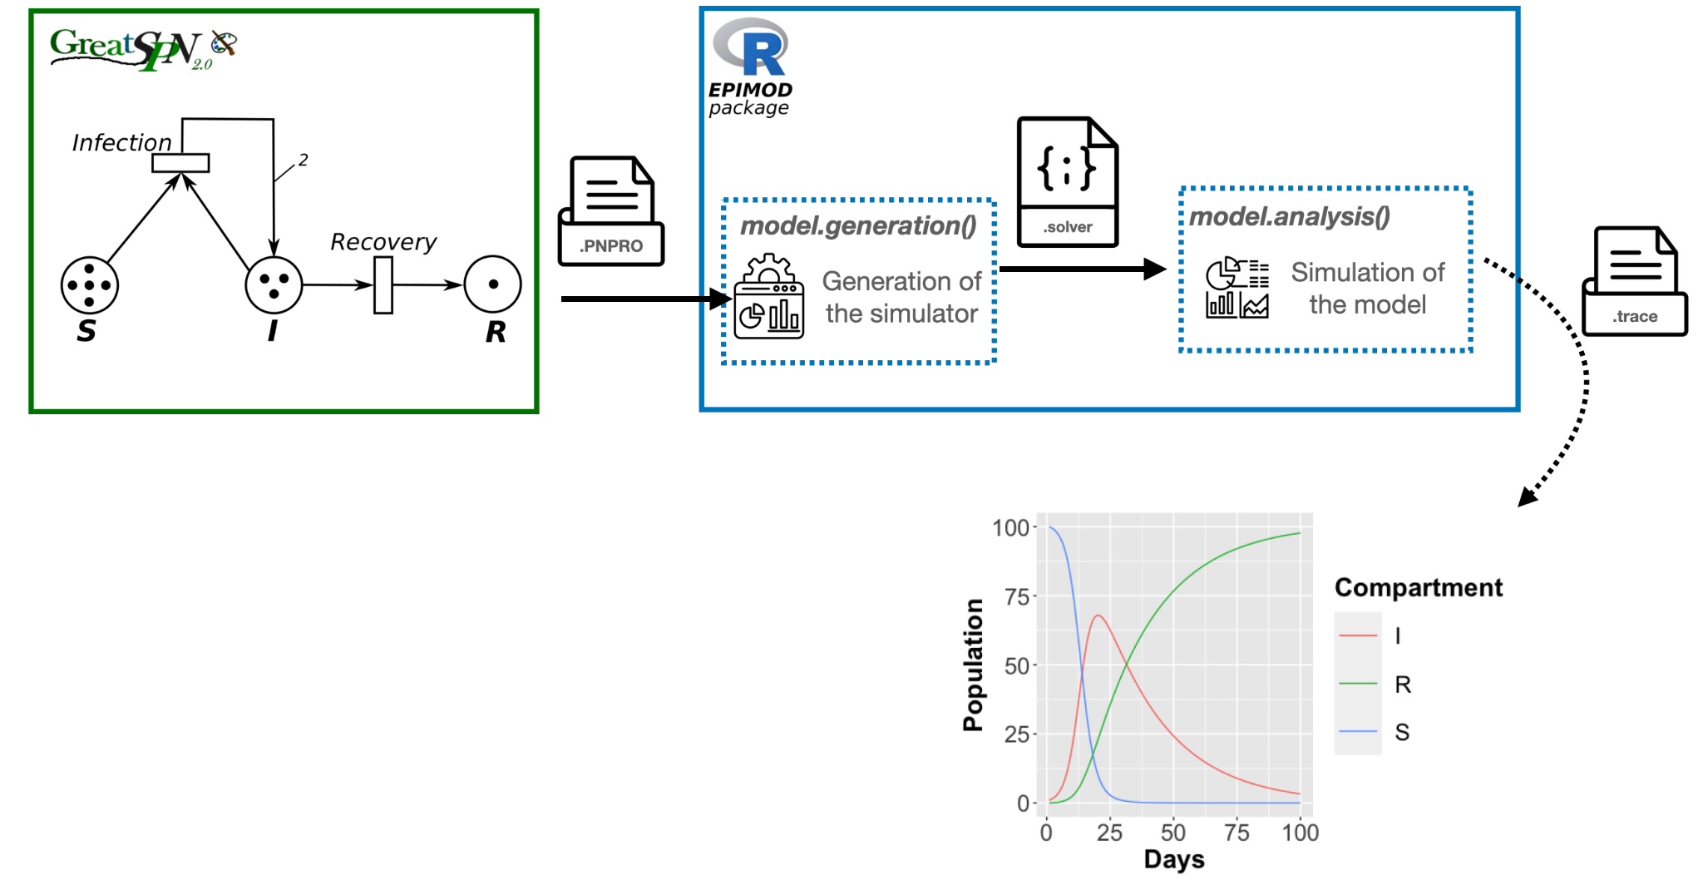
From graphics to dynamics

Slide 43
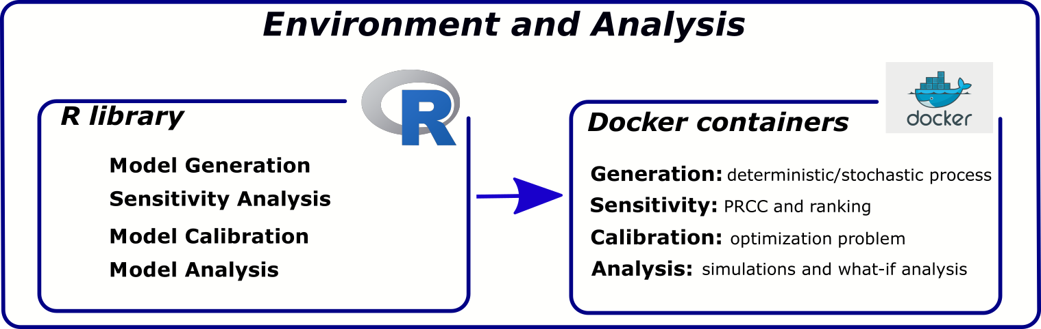
Epimod
General modeling framework for the analysis of epidemiological/biological systems;
Tool easily accessible by any researcher even without advanced mathematical and computational skills.
Main features:
• Graphical formalism: you don’t have to write equations, you draw them!
• Modular: you can shuffle the components to get what you need
• R package: no configuration is needed, you just install it
• Virtualization with Docker: the framework runs on on your laptop and rocks on your data-center

Slide 44

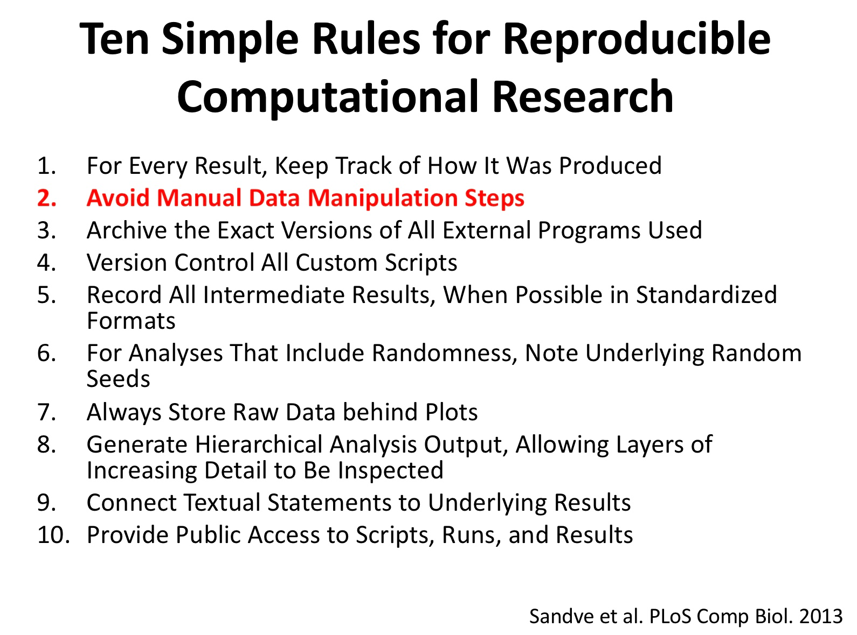
Docker containerization
Reproducibility is guaranteed by providing Docker containers packing all the required software and libraries frozen at a given version.
Docker images are equivalent to Virtual Machines but Docker container provide an operating-system-level virtualization by abstracting the user space rather then the hardware, so that all the running docker images share the same kernel.
Abstracting the user space guarantees better performance at the cost of minor portability (i.e., docker images built on Linux will not run on Windows systems.)

Slide 45
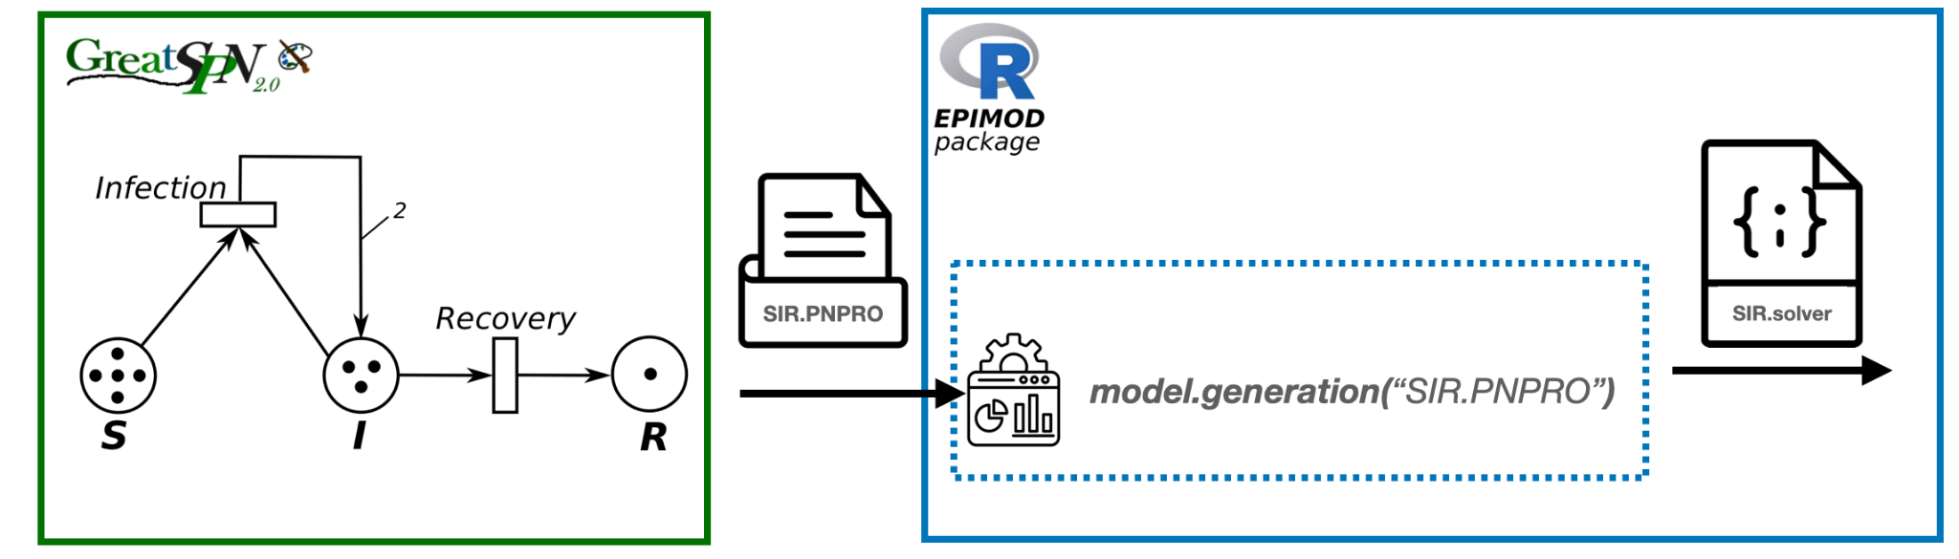
Model Generation
model_generation(): generate the implementation of the model (both deterministic and stochastic) from its graphical representation

Slide 46
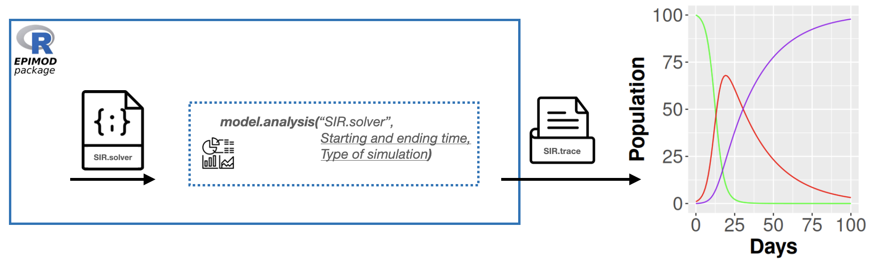
Model Analysis
model_analysis(): play with your brand new model

Slide 47

Model Analysis
model_analysis(): play with your brand new model
The simulations depend on the parameters (initial state and transition rates) set from GreatSPN

Slide 48
Changing Model Parameters
The simulations depend on the parameters (initial state and transition rates) set from GreatSPN
Change parameters from GreatSPN
Change parameters from model_analysis()

Slide 49
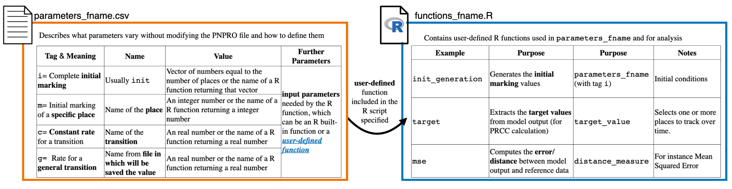
Changing Model Parameters
The simulations depend on the parameters (initial state and transition rates) set from GreatSPN
Change parameters from model_analysis()

Slide 50
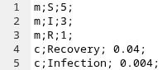
Changing Model Parameters
Simple example:

Slide 51
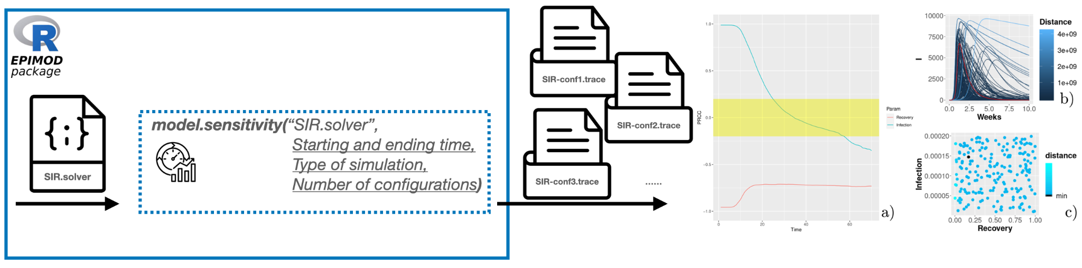
Model Sensitivity
model_sensitivity(): identify the set of parameter that impact the most on the model outcome (dynamics) with the Partial Rank Correlation Coefficients
a) Study the input parameters through the PRCC.
b-c) Study the parameter search space with respect to the the reference data

Slide 52
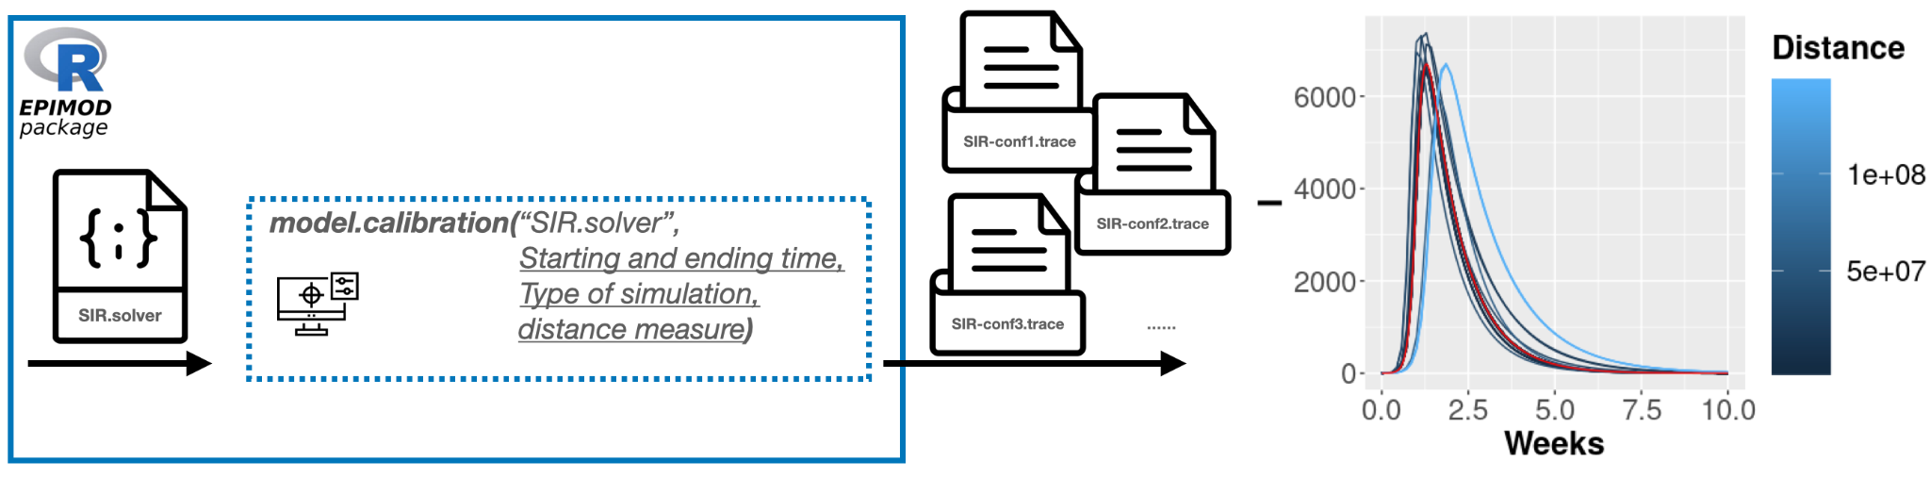
Model Calibration
model_calibration(): estimate the parameters configuration which fit the best a given reference data.
Minimise the distance between the reference data and the model’s output according to a given (user
provided) distance metric.

Slide 53
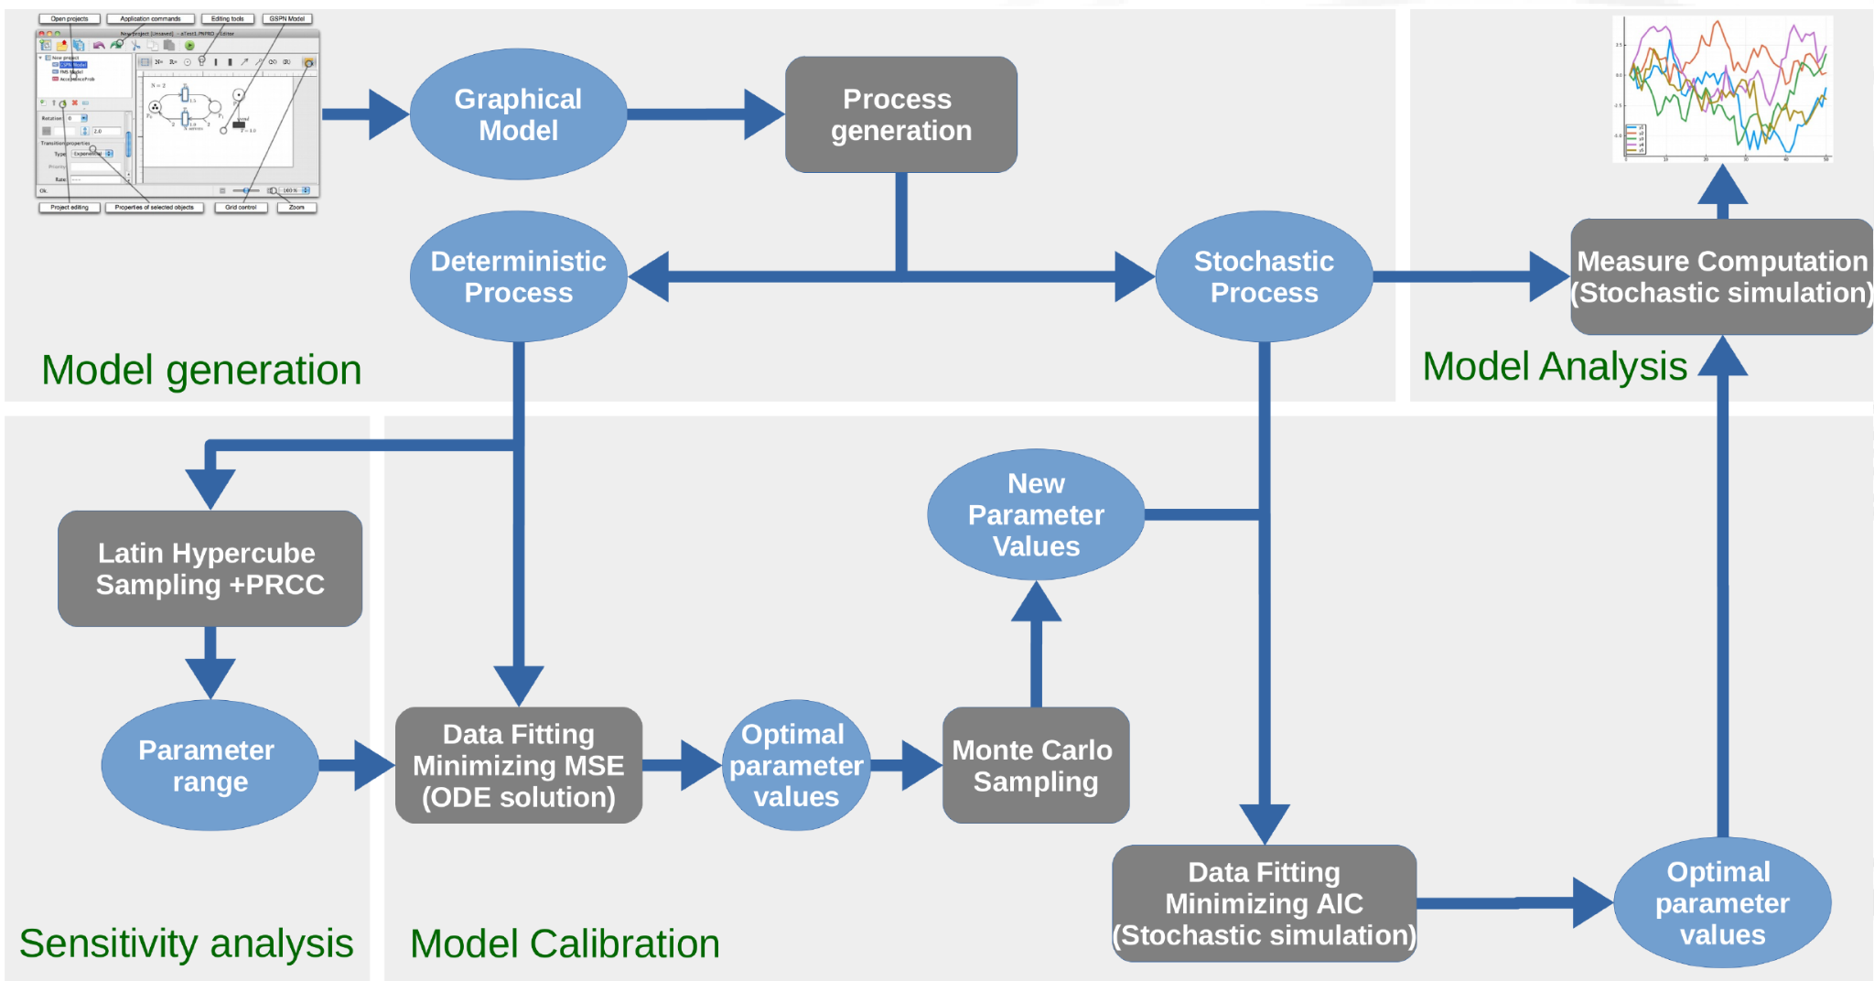
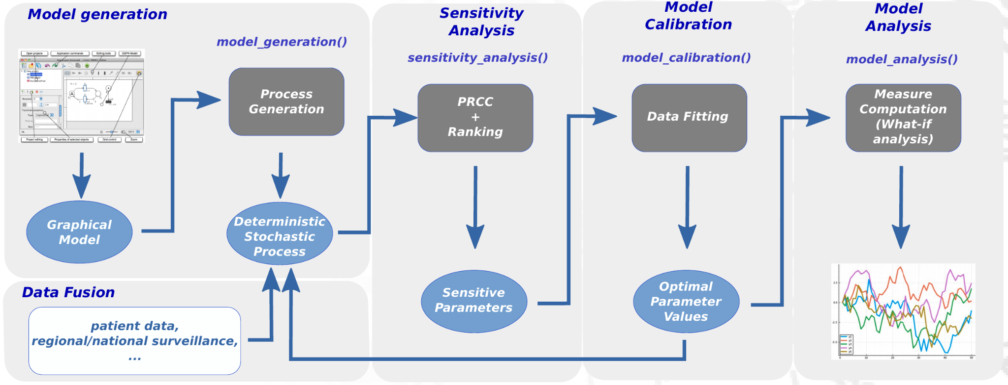
Epimod is modular
Analysis pipeline for Pertussis model
Analysis pipeline for COVID-19 model

Slide 54

Case study: SIR model

Slide 55
Micro-level models

Slide 56


Micro-level models
The second major class of modeling approaches: Micro-Level Models, often called agent-based models (ABMs).
ABMs have two main components: agents and the environment. Agents represent individual people, each following their own rules, behaviors, and decision-making processes rather than being grouped. The environment provides the specific space or setting where these agents interact and carry out their decisions.
Some key features of these models include:
Each agent can have different characteristics.
Interactions depend on who meets whom, when, and where.
Agents can move, change behavior, and react to their environment.
From these individual interactions, complex global patterns, like waves of infection or clustering, can emerge over time.
The strength of these models lies in their realism. They help explore questions like:
What if some people are super-spreaders?
How do contact patterns affect the outbreak?
Can we target specific groups or locations to slow the spread?
We simulate interactions in detail, like a crowd of individuals, each making their own decisions.
While they’re more complex and slower to run, they’re excellent for understanding detailed dynamics.

Slide 57



Agent-based models in infectious disease modeling
We simulate interactions in detail, like a crowd of individuals, each making their own decisions.
While they’re more complex and slower to run, they’re excellent for understanding detailed dynamics.
Susceptible
Infected
Recovered
Agents can be Susceptible (S), Infected (I), or Recovered (R), just like in the SIR model, but interactions are local, not global.
Unlike compartment models...
No assumption of perfect mixing.
Infection spreads through local contact and shared spaces, e.g., in neighborhoods, households, or workplaces.
The outcomes are stochastic (random), and we often run simulations many times to explore possibilities.

Slide 58
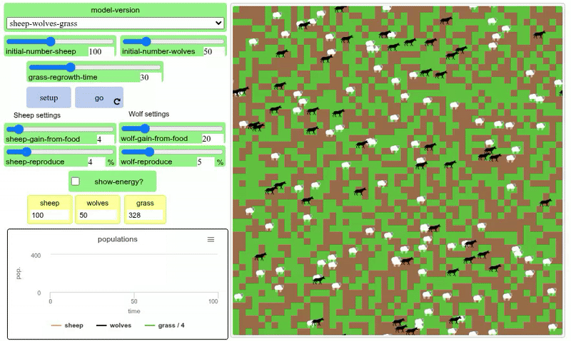
ABM environment
Wolf Sheep Predation
Spatial (grid or continuous space):
Agents move across physical spaces (e.g., cities, maps).
Supports location-based interactions.
Examples: predator-prey models, traffic flow, school.
From https://ccl.northwestern.edu/netlogo/models/
Wilensky, U. (1999). NetLogo. Center for Connected Learning and Computer-Based Modeling, Northwestern University, Evanston, IL.

Slide 59
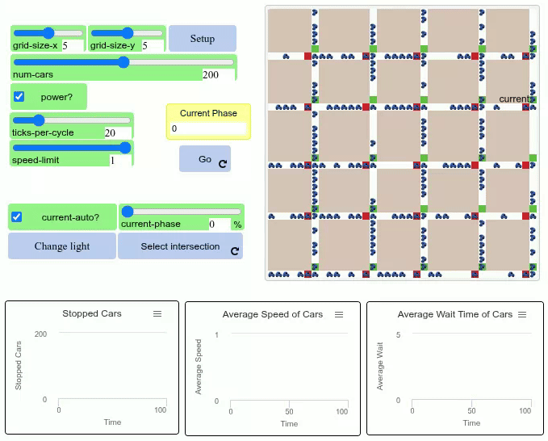
ABM environment
Traffic Grid
Spatial (grid or continuous space):
Agents move across physical spaces (e.g., cities, maps).
Supports location-based interactions.
Examples: predator-prey models, traffic flow, school.
From https://ccl.northwestern.edu/netlogo/models/
Wilensky, U. (1999). NetLogo. Center for Connected Learning and Computer-Based Modeling, Northwestern University, Evanston, IL.

Slide 60
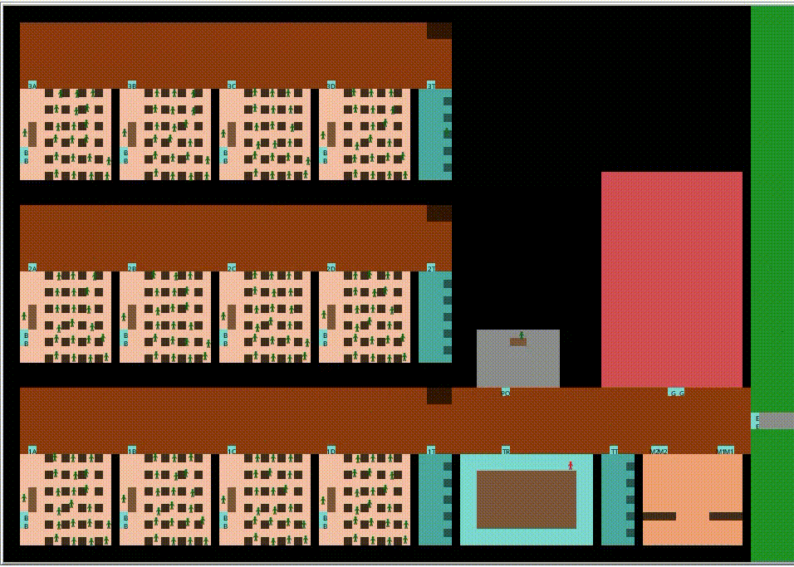
ABM environment
School model
Spatial (grid or continuous space):
Agents move across physical spaces (e.g., cities, maps).
Supports location-based interactions.
Examples: predator-prey models, traffic flow, school.
Baccega, Daniele, et al. "An agent-based model to support infection control strategies at school." JASSS 25.3 (2022): 1-15.
Baccega, Daniele, et al. "Living along COVID-19: assessing contention policies through Agent-Based Models." International Meeting on Computational Intelligence Methods for Bioinformatics and Biostatistics. Springer, Cham, 2025.
Wilensky, U. (1999). NetLogo. Center for Connected Learning and Computer-Based Modeling, Northwestern University, Evanston, IL.

Slide 61
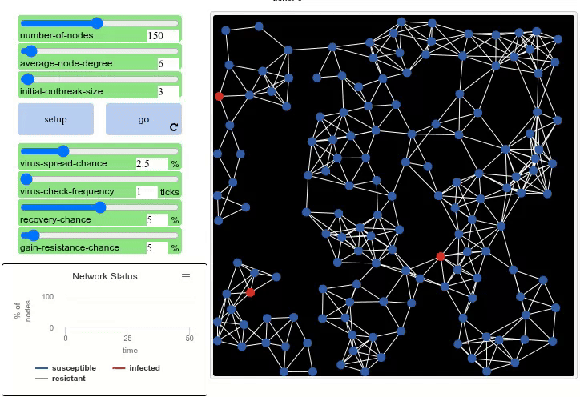
ABM environment
Virus on a Network
Network-based:
Agents are nodes connected by relationships (edges).
Useful for modeling social influence, disease spread, communication.
Examples: social networks, power grids.
From https://ccl.northwestern.edu/netlogo/models/
Wilensky, U. (1999). NetLogo. Center for Connected Learning and Computer-Based Modeling, Northwestern University, Evanston, IL.

Slide 62
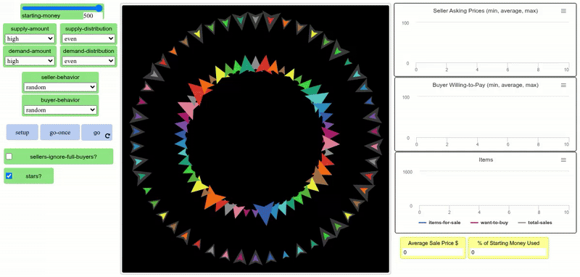
ABM environment
Bidding market
Abstract or conceptual:
Represents non-physical dimensions (e.g., markets, belief systems).
Agents interact based on logical conditions or data.
Examples: bidding market, voting.
From https://ccl.northwestern.edu/netlogo/models/
Wilensky, U. (1999). NetLogo. Center for Connected Learning and Computer-Based Modeling, Northwestern University, Evanston, IL.

Slide 63







ABM tools
NetLogo
Repast Simphony
Repast HPC
Mason
FLAME
…
FLAME GPU 2
BioDynaMo
GEMSim
SIMCoV-GPU
…

Slide 64
NetLogo
What is NetLogo?
NetLogo is a simulation environment for building and exploring agent-based models, designed to run on the CPU.
Why use it?
Simulate real-world systems (e.g., ecosystems, traffic, markets).
Visual + interactive = great for learning & experimentation.
Easy to start, powerful to scale up.
Baccega, Daniele, et al. "An agent-based model to support infection control strategies at school." JASSS 25.3 (2022): 1-15.
Baccega, Daniele, et al. "Living along COVID-19: assessing contention policies through Agent-Based Models." International Meeting aon Computational Intelligence Methods for Bioinformatics and Biostatistics. Springer, Cham, 2025.
Wilensky, U. (1999). NetLogo. Center for Connected Learning and Computer-Based Modeling, Northwestern University, Evanston, IL.

Slide 65
NetLogo
✅ Pros
Easy to learn, beginner-friendly.
Visual feedback for real-time learning.
Huge built-in model library.
Supports complex behavior with simple code.
Cross-platform and free.
❌ Cons
Slower with very large agent counts.
No parallelization.
Not ideal for heavy numerical computations.
Scripting language unique to NetLogo (not general-purpose).
Baccega, Daniele, et al. "An agent-based model to support infection control strategies at school." JASSS 25.3 (2022): 1-15.
Baccega, Daniele, et al. "Living along COVID-19: assessing contention policies through Agent-Based Models." International Meeting on Computational Intelligence Methods for Bioinformatics and Biostatistics. Springer, Cham, 2025.
Wilensky, U. (1999). NetLogo. Center for Connected Learning and Computer-Based Modeling, Northwestern University, Evanston, IL.

Slide 66
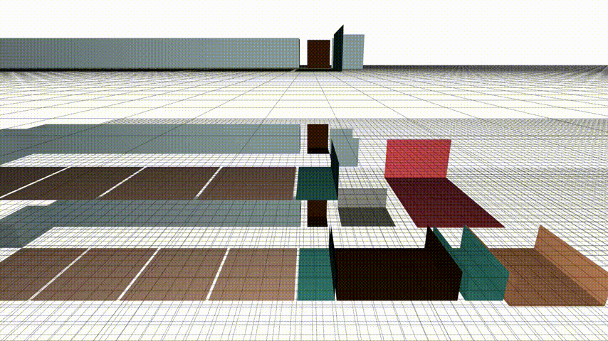
FLAME GPU 2
What is FLAME GPU 2?
FLAME GPU 2 is a high-performance agent-based modeling framework designed for GPU acceleration using NVIDIA CUDA.
Why use it?
Ideal for large-scale, computationally intensive models.
Massively parallel: leverages the GPU to simulate millions of agents.
Great for fields like biology, transportation, crowd simulation, and epidemiology.
Baccega, D., et al. "Forge4Flame: An Intuitive Dashboard for Designing GPU Agent-Based Models to Simulate Infectious Disease Spread." Available at SSRN 5194584.
P. Richmond, R. Chisholm, P. Heywood, M. Leach, and M. Kabiri Chimeh, FLAME GPU. Zenodo, 2021. doi: 10.5281/ZENODO.5428984.

Slide 67
FLAME GPU 2
✅ Pros
Extreme scalability: handles millions of agents.
GPU acceleration = faster simulations.
Custom C++ agent logic.
Integration with Python.
❌ Cons
Steeper learning curve than GUI-based tools.
Requires CUDA-capable GPU and some C++ knowledge.
Less beginner-friendly for quick prototyping.
Limited built-in visualization (compared to NetLogo).
Baccega, D., et al. "Forge4Flame: An Intuitive Dashboard for Designing GPU Agent-Based Models to Simulate Infectious Disease Spread." Available at SSRN 5194584.
P. Richmond, R. Chisholm, P. Heywood, M. Leach, and M. Kabiri Chimeh, FLAME GPU. Zenodo, 2021. doi: 10.5281/ZENODO.5428984.

Slide 68
Well-defined closed environment
These scenarios feature detailed simulation of agents’ movements within a confined and structured space.
Very complex to define.
Examples: school, hospital, supermarket, office.
Baccega, D., et al. "Forge4Flame: An Intuitive Dashboard for Designing GPU Agent-Based Models to Simulate Infectious Disease Spread." Available at SSRN 5194584.

Slide 69

Forge4Flame: An Intuitive Dashboard for Designing GPU Agent-Based Models to Simulate Infectious Disease Spread
Baccega, D., et al. "Forge4Flame: An Intuitive Dashboard for Designing GPU Agent-Based Models to Simulate Infectious Disease Spread." Available at SSRN 5194584.

Slide 70


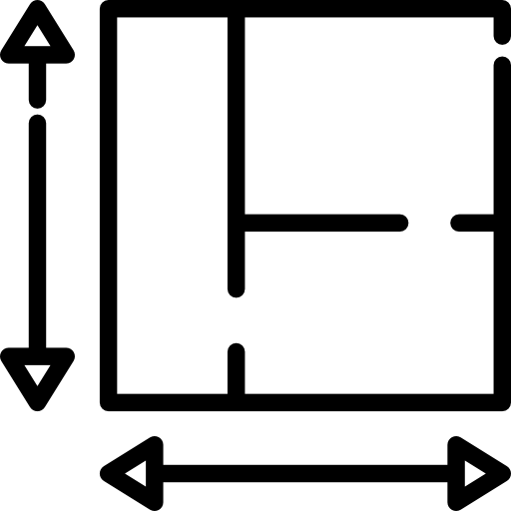


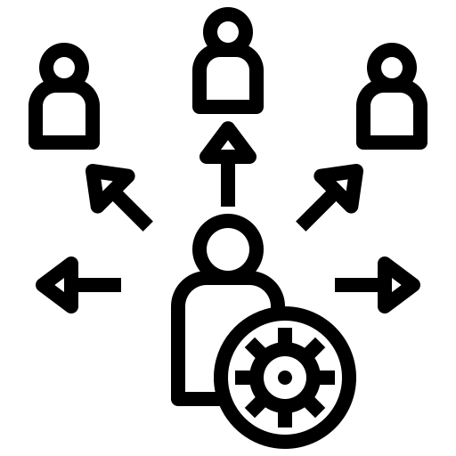



Forge4Flame: introduction
User-friendly dashboard designed to simplify the definition of an Agent-Based Model environment without the need to write code.
User-friendly
Approachable by scientists without specific computational knowledge
It enables to define:
model’s environment
the agents interacting within it
the disease model
other components relevant to an agent-based simulation of disease spread
Simple visualisations
Automatic
Automatic generation of 3D model environment for FLAME GPU 2
Reproducibility
Scientific results can be consistently replicated by independent researchers using the same methodology and data
Baccega, D., et al. "Forge4Flame: An Intuitive Dashboard for Designing GPU Agent-Based Models to Simulate Infectious Disease Spread." Available at SSRN 5194584.

Slide 71
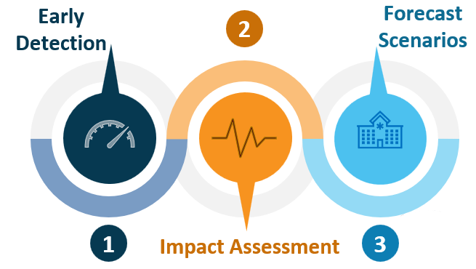

How it started…
TrustAlert
Platform for the analysis of near real-time stream of healthcare data
Founded by Compagnia San Paolo
1M Euro Project
7 Collaborators
Our objectives in this project:
Evaluate the potential impacts of a health emergency in a real case scenario (Cottolengo Hospital in Turin) at different levels of detail, spanning from different simulation paradigms (e.g., ABM).
Expected results:
Being able to simulate the behavior of the "Hospital" system, for what happens outside, will allow Cottolengo Hospital to be able, in the medium term, not only to be effective but to improve the efficiency (cost / result ratio) and response capacity to ensure the delivery of health services.

Slide 72
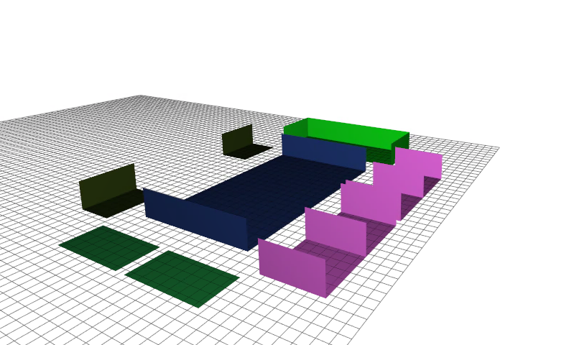



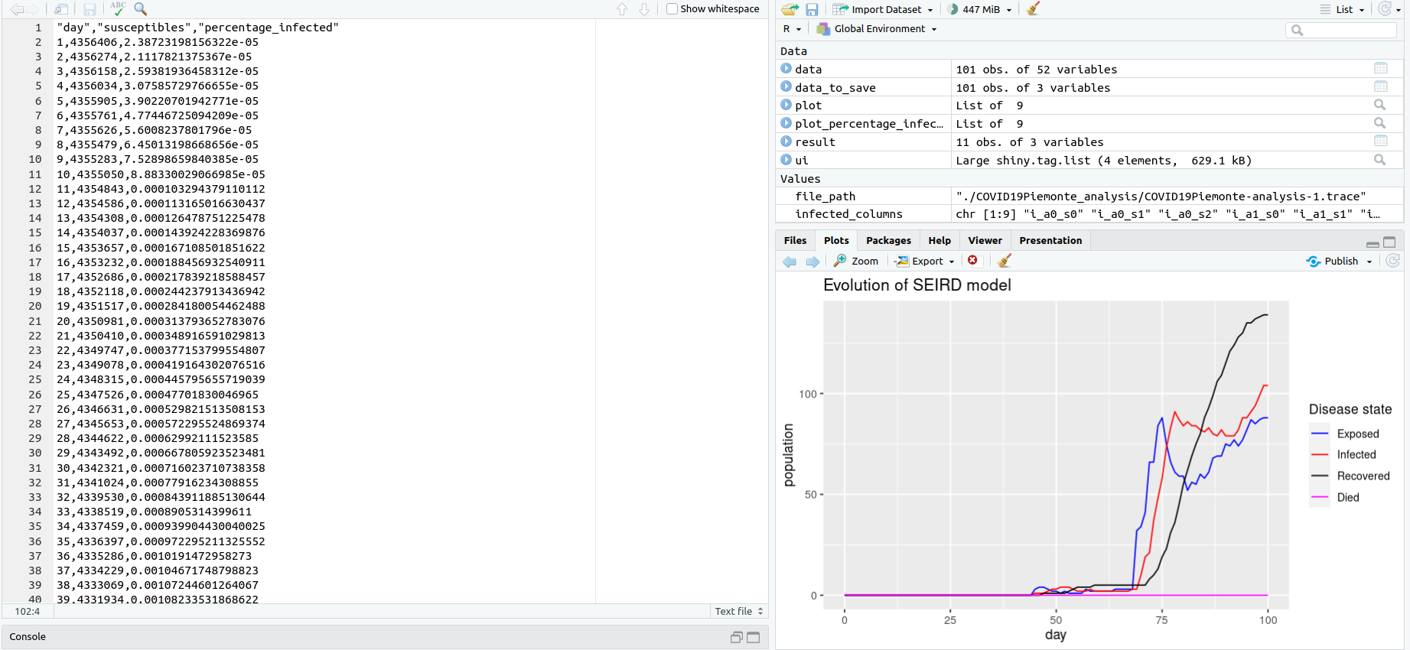


Pipeline
3D ABM Visualisation
WHOLEmodel.json
ABM Environment
Epidemic Evolution

Slide 73
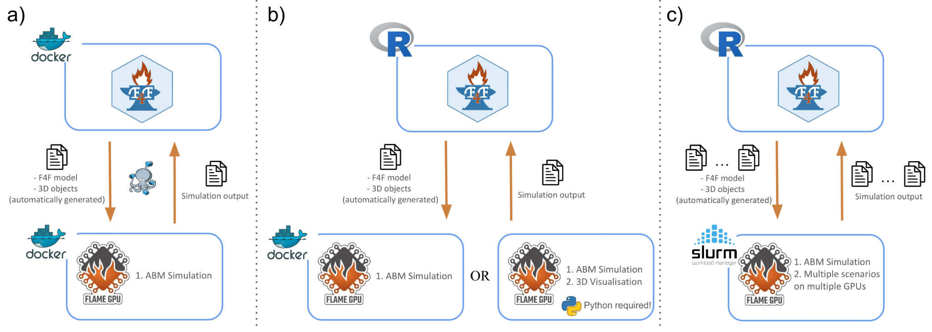
Docker pipeline

Slide 74
Docker pipeline

Slide 75
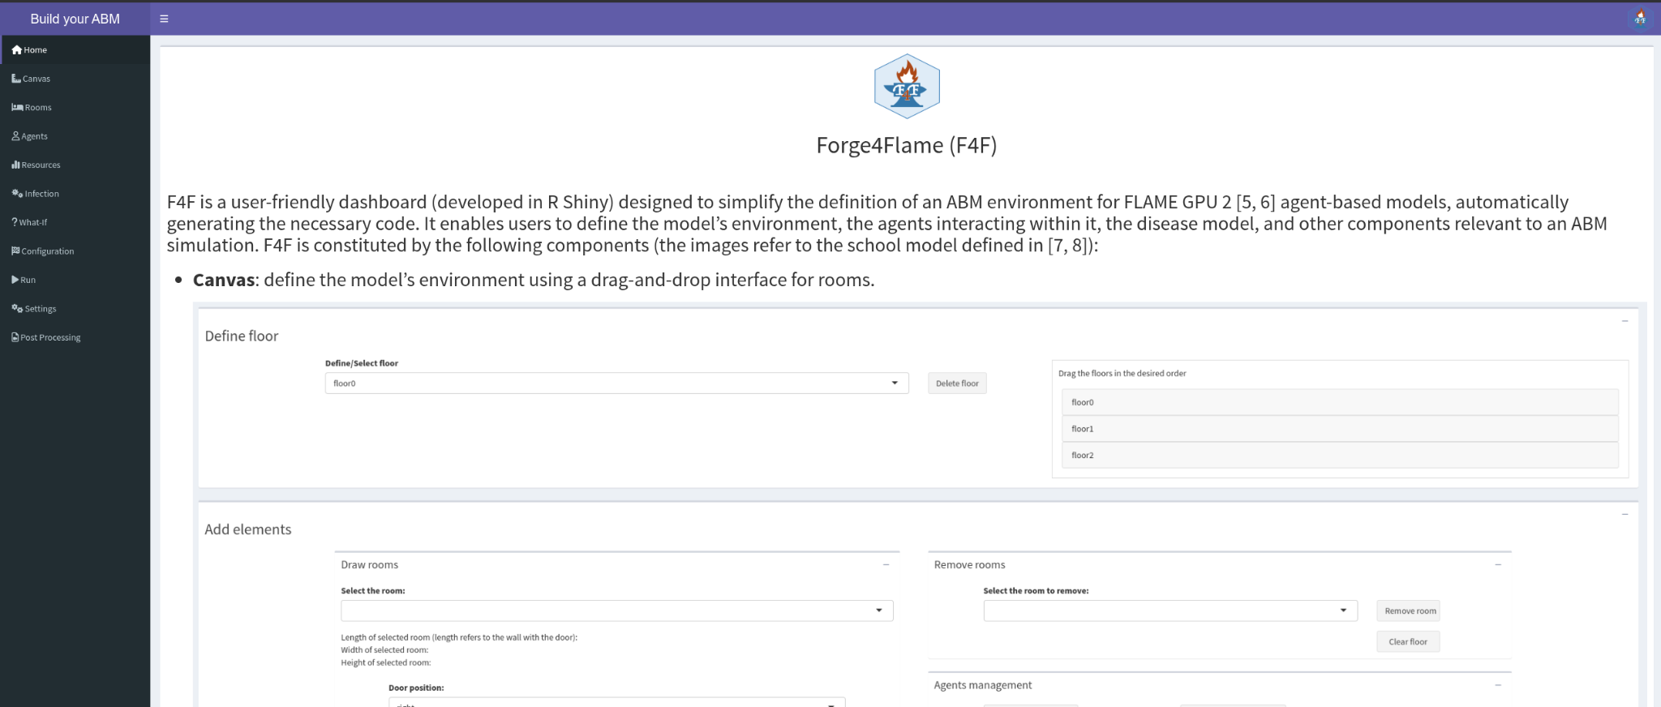
Homepage

Slide 76


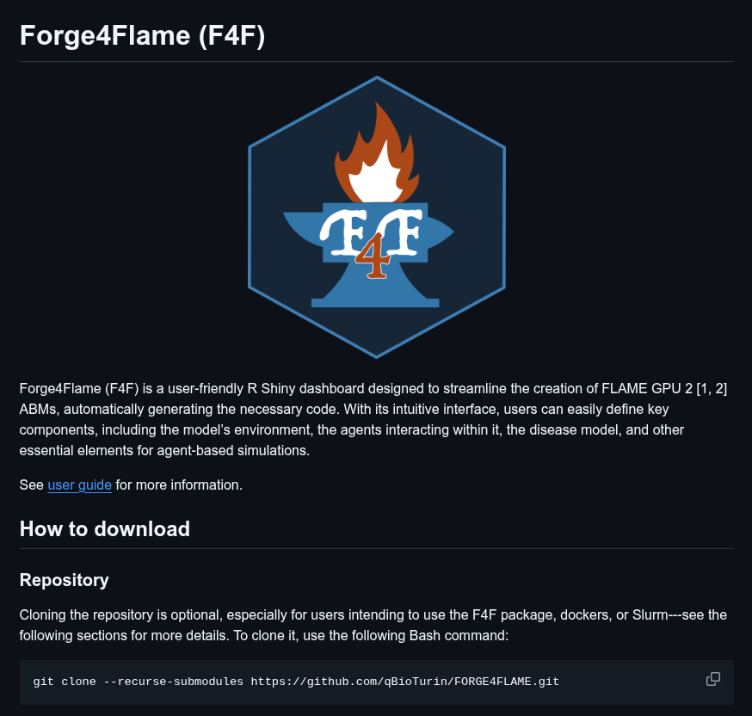
How to install and run
GitHub
The user can run F4F:
Installing and running the R package.
Downloading and running the provided Docker image.
See the GitHub page for more details.
http://github.com/qBioTurin/IEEEICHI2025
Baccega, D., et al. "Forge4Flame: An Intuitive Dashboard for Designing GPU Agent-Based Models to Simulate Infectious Disease Spread." Available at SSRN 5194584.

Slide 77
Case study: small ambulatory
Clinics
12 doctors and 12 receptionists are divided across three shifts (6 AM–2 PM, 2 PM–10 PM, and 10 PM–6 AM). Doctors remain in the clinic during their shifts, while receptionists stay at the reception.
On average, 20 patients visit the clinic per day, each required to attend four weekly appointments. They check in at the reception (∽5 min) and proceed to the clinic (∽40 min), waiting their turn in the respective waiting rooms.
Each individual may use the bathroom with a predefined probability: 1.4e⁻⁴ for both receptionists and doctors, and 2.8e⁻⁴ for patients.
Waiting room for patients
Useless room
Receptions
Corridor
Entrance
Patient’s
Bathroom
Personnel’s
Bathroom

Slide 78
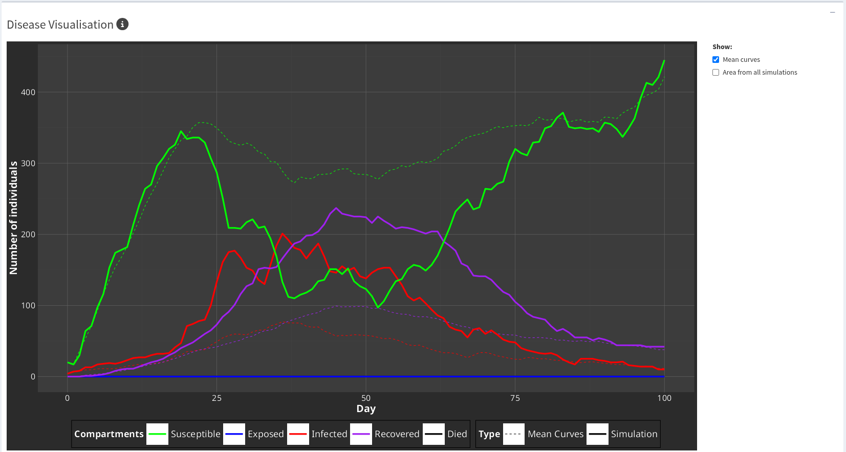
Case study: small ambulatory
Clinics
Waiting room for patients
Useless room
Receptions
Corridor
Entrance
Patient’s
Bathroom
Personnel’s
Bathroom

Slide 79
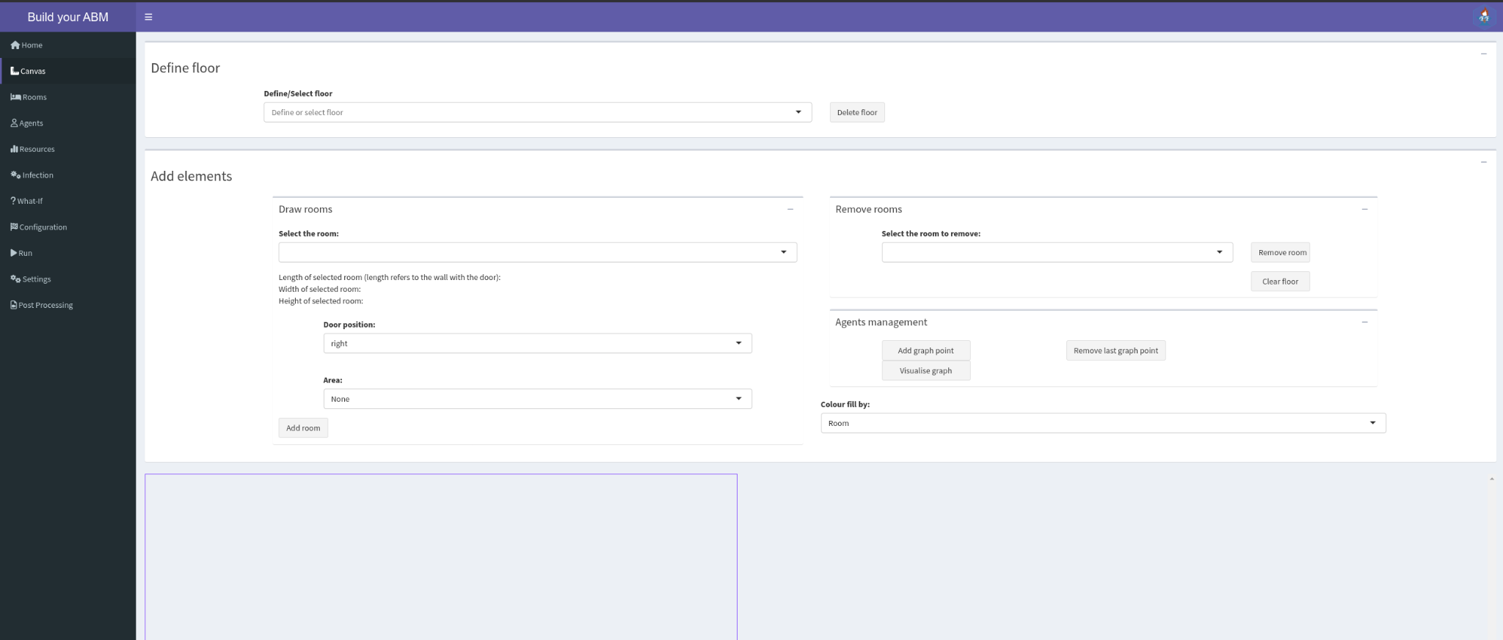
Canvas page with empty canvas
Rooms → Floors → Agents → Resources → Disease → What If → Configuration → Run & Settings → Post Processing
The canvas represents a plane (or floor) where predefined rooms can be added and positioned using drag and drop. At least one floor has to be defined.
Before building the environment, rooms must be defined.

Slide 80
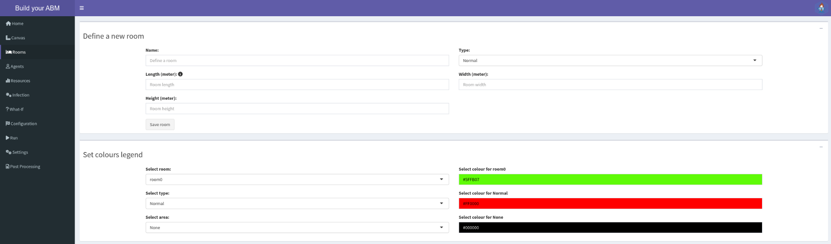
Rooms page
Rooms → Floors → Agents → Resources → Disease → What If → Configuration → Run & Settings → Post Processing
A room is defined by:
3 dimensions (Length, Width, Height),
name (room’s id), and
type (to group rooms into clusters)
It is possible to define and change the color of rooms, types and areas displayed in the Canvas.

Slide 81




Rooms page: predefined rooms’ type
Rooms → Floors → Agents → Resources → Disease → What If → Configuration → Run & Settings → Post Processing
Filling-rooms: room type utilized by agents to simulate walls or useless rooms.
Spawn-rooms: room type utilized by agents to enter (and exit) the environment.
Stairs: room type utilized by agents to move among floors.
Waiting-rooms: room type utilized by agents to wait to enter in another room.

Slide 82
Canvas page
Rooms → Floors → Agents → Resources → Disease → What If → Configuration → Run & Settings → Post Processing
Each room may be assigned to a particular area (e.g., a specific area of a hospital). This is useful restrict the areas in which agents can go.

Slide 83
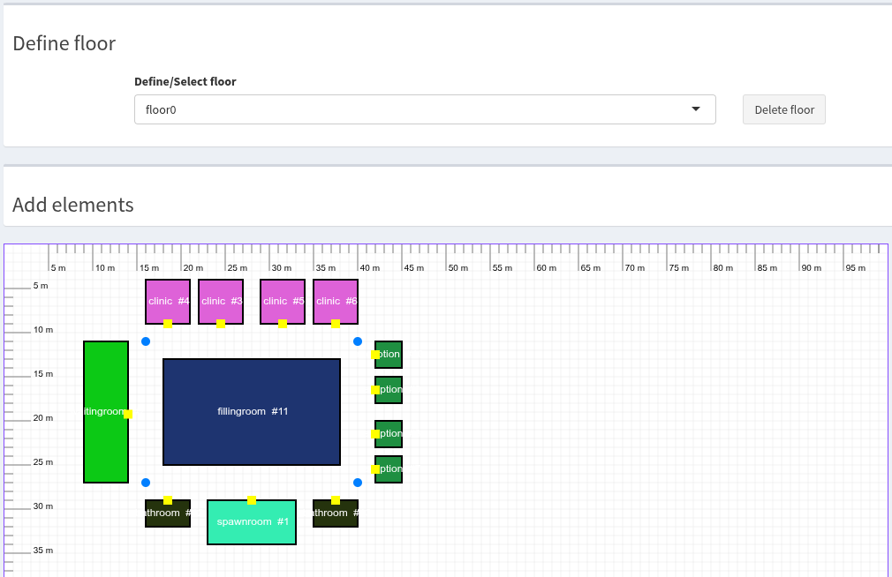
Canvas page: floor0
Rooms → Floors → Agents → Resources → Disease → What If → Configuration → Run & Settings → Post Processing

Slide 84
Canvas page: graph points
Rooms → Floors → Agents → Resources → Disease → What If → Configuration → Run & Settings → Post Processing
It is possible to add graph points to insert a new node into the agents’ movement graph.
By default, each door and room center corresponds to a node in this graph.

Slide 85
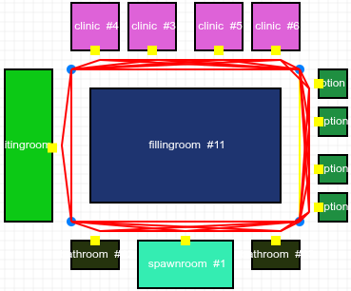
Canvas page: graph points
Rooms → Floors → Agents → Resources → Disease → What If → Configuration → Run & Settings → Post Processing
It is possible to generate and visualise all the possible paths that the agents might follow.

Slide 86

Agents
Rooms → Floors → Agents → Resources → Disease → What If → Configuration → Run & Settings → Post Processing
Agent definition
Determined flow
Random flow
Entry/Exit flow

Slide 87

Agent page: agent definition
Rooms → Floors → Agents → Resources → Disease → What If → Configuration → Run & Settings → Post Processing
An agent is defined by:
a name,
a class (category that groups different types of agents), and
the number of agents in the simulation.

Slide 88

Agent page: agent determined flow
Rooms → Floors → Agents → Resources → Disease → What If → Configuration → Run & Settings → Post Processing
The user can select the intensity of the activity that the agent performs in the selected room. This is important to determine the quantity of quanta exhaled by an infected agent.
Options: very light, light, quite hard, hard.
The flow must always begin and end with the spawn-room.

Slide 89

Agent page: agent random flow
Rooms → Floors → Agents → Resources → Disease → What If → Configuration → Run & Settings → Post Processing
The user can add random events that interrupt the agent’s determined flow.
By default the event Do nothing is present with probability 1.
The probability that an event might occur will be checked every step.

Slide 90

Agent page: agent time window
Rooms → Floors → Agents → Resources → Disease → What If → Configuration → Run & Settings → Post Processing
The user can define the entry time and the specific days of the week when the agent will enter the environment.
The number of agents is specified in the agent definition panel.

Slide 91

Agent page: agent daily rate
Rooms → Floors → Agents → Resources → Disease → What If → Configuration → Run & Settings → Post Processing
The user can define an entrance rate for the agent using either a deterministic value or a stochastic distribution, along with specifying an initial and a final generation time and and the specific days of the week when the agent will enter the environment.

Slide 92

Resources page
Rooms → Floors → Agents → Resources → Disease → What If → Configuration → Run & Settings → Post Processing
For each room, the list of all agents that might reach it is showed.
The user can set the rooms’ resources available for each agent.
Resources: the number of agents that can occupy a room simultaneously.

Slide 93

Resources page
Rooms → Floors → Agents → Resources → Disease → What If → Configuration → Run & Settings → Post Processing

Slide 94

Infection page
Rooms → Floors → Agents → Resources → Disease → What If → Configuration → Run & Settings → Post Processing
The evolution of the infection is modeled through a compartmental model.
SIR: Susceptible - Infected - Recovered.
Two contagion processes: contact [1] and aerosol [2].
[1] Hoertel, N., et al. A stochastic agent-based model of the SARS-CoV-2 epidemic in France.
[2] Gkantonas, S., et al. airborne.cam: A risk calculator of SARS-CoV-2 aerosol transmission under well-mixed ventilation conditions.

Slide 95

Infection page: SEIRDS
Rooms → Floors → Agents → Resources → Disease → What If → Configuration → Run & Settings → Post Processing
𝛽_{contact} and 𝛽_{aerosol} are not the infection rates!
SEIRDS: Susceptible - Exposed - Infected - Recovered - Dead - Susceptible.

Slide 96

What-If page
Rooms → Floors → Agents → Resources → Disease → What If → Configuration → Run & Settings → Post Processing
What-If scenarios are useful to understand the potential impact of hypothetical situations.
Options:
Environmental ventilation
Masks usage
Virus parameters
Vaccination
Swabs (internal screening)
Quarantine
External screening
Initial infected
Outside contagion

Slide 97


What-If page: ventilation
Rooms → Floors → Agents → Resources → Disease → What If → Configuration → Run & Settings → Post Processing
Global
Ventilation is a process that replace contaminated with clean air at n Air Changes per Hour (ACH).
Options: no ventilation, poorly ventilated, domestic, offices/school, well ventilated, typical maximum, hospital setting.
Different for each room

Slide 98


What-If page: masks
Rooms → Floors → Agents → Resources → Disease → What If → Configuration → Run & Settings → Post Processing
Global
Masks reduce the virus inhalation and exhalation rate.
Different for each agent
Options: no mask, surgical, FFP2.

Slide 99


What-If page: vaccination
Rooms → Floors → Agents → Resources → Disease → What If → Configuration → Run & Settings → Post Processing
Global
Vaccination immunizes people by putting them in the Recovered state.
Different for each agent
Vaccine efficacy models the fraction of the vaccinated population that is effectively immune to infection.

Slide 100


What-If page: swab
Rooms → Floors → Agents → Resources → Disease → What If → Configuration → Run & Settings → Post Processing
Global
Internal screening campaigns are useful to detect infected people and to monitor the spread of the infection in the environment.
Different for each agent
These screening campaigns are conducted within the environment!
These screening campaigns are conducted within the environment!

Slide 101


What-If page: quarantine
Rooms → Floors → Agents → Resources → Disease → What If → Configuration → Run & Settings → Post Processing
Global
Isolating infected people is useful to slow down the spread of the virus.
Different for each agent

Slide 102


What-If page: external screening
Rooms → Floors → Agents → Resources → Disease → What If → Configuration → Run & Settings → Post Processing
External screening campaigns are useful to account for interactions outside the environment.
Global
Two probabilities:
test an individual because he/she follows activities that involve screening campaigns (like practise sports)
test an infected individual due to symptoms.
Different for each agent

Slide 103

What-If page: virus
Rooms → Floors → Agents → Resources → Disease → What If → Configuration → Run & Settings → Post Processing
Virus variant factor models the virus or a particular variant of the virus under study [1].
Virus severity models the fraction of infected with severe symptoms [2].
[1] J.L. Jimene, et al. COVID-19 Aerosol Transmission Estimator.
[2] Tolksdorf K, et al. Influenza-associated pneumonia as reference to assess seriousness of coronavirus disease (COVID-19).

Slide 104



What-If page: initial infected
Rooms → Floors → Agents → Resources → Disease → What If → Configuration → Run & Settings → Post Processing
Random
Global
The number of initial infected within the environment can pilot the evolution of the infection.
Different for each agent

Slide 105

What-If page: outside contagion
Rooms → Floors → Agents → Resources → Disease → What If → Configuration → Run & Settings → Post Processing
Outside contagion accounts for the fact that any individual will likely catch the infection outside the environment.

Slide 106

Configuration page
Rooms → Floors → Agents → Resources → Disease → What If → Configuration → Run & Settings → Post Processing
Definition of some basic configurations

Slide 107

Run page
Rooms → Floors → Agents → Resources → Disease → What If → Configuration → Run & Settings → Post Processing
Run a defined model.

Slide 108

Setting page
Rooms → Floors → Agents → Resources → Disease → What If → Configuration → Run & Settings → Post Processing
Definition of some settings, load/save models, references

Slide 109

Post Processing page
Rooms → Floors → Agents → Resources → Disease → What If → Configuration → Run & Settings → Post Processing

Slide 110

Post Processing page: query
Rooms → Floors → Agents → Resources → Disease → What If → Configuration → Run & Settings → Post Processing
Simulations can be filtered using queries on disease status.
The user can inspect a specific simulation.

Slide 111
Post Processing page: disease evolution
Rooms → Floors → Agents → Resources → Disease → What If → Configuration → Run & Settings → Post Processing
Disease progression in the selected simulation (with average).

Slide 112

Post Processing page: other plots
Rooms → Floors → Agents → Resources → Disease → What If → Configuration → Run & Settings → Post Processing
Some other useful information in the selected simulation (with average).

Slide 113

Post Processing page: contacts and virus concentration
Rooms → Floors → Agents → Resources → Disease → What If → Configuration → Run & Settings → Post Processing
Number of contacts and virus concentration inside the waiting room.

Slide 114

Post Processing page: 2D visualization
Rooms → Floors → Agents → Resources → Disease → What If → Configuration → Run & Settings → Post Processing
2D visualization in Forge4Flame

Slide 115

Post Processing page: contact matrix
Rooms → Floors → Agents → Resources → Disease → What If → Configuration → Run & Settings → Post Processing
Contact matrix among all the defined agents’ types

Slide 116
3D visualization in FLAME GPU 2
3D visualisation provided by FLAME GPU 2

Slide 117
Case study: small ambulatory
Clinics
Waiting room for patients
Useless room
Receptions
Corridor
Entrance
Patient’s
Bathroom
Personnel’s
Bathroom
http://github.com/qBioTurin/IEEEICHI2025

Slide 118
From macro- to micro-level models

Slide 119

From macro to micro-level models

Slide 120




From macro to micro-level models

Slide 121

Conclusion
Estimating Intervention Impact Both macro and micro models help assess policies like lockdowns and vaccinations, each with their own strengths and limitations.
Individual Behavior Matters Micro-level models offer detailed insights into how personal choices shape epidemic dynamics.
Simplicity vs. Detail A key modeling challenge—striking the right balance depends on your goal: explanation, forecasting, or policy evaluation.
Choosing the Right Model
Macro models: Best for broad trends, quick insights, low data requirements.
Micro models: Ideal for detailed scenarios, heterogeneous behavior, and exploring emergent effects.
📩 We’ll be around during the entire conference!
🛠️ Found bugs or have suggestions? Leave feedback on our GitHub.
We hope you’ve gained a clearer understanding of when and how to use different computational models to study and respond to epidemics.
simone.pernice@unito.it
irene.terrone@unito.it
daniele.baccega@unito.it
‹#›

Slide 122


Thank you for the attention!
https://qbio.di.unito.it/

